Slide 1
Big Data graduation project Covid-19
By : Omar Mohamed

Slide 2
Outlines :
INGESTION
STORAGE
PROCESSING
OOZIE WORKFLOW
VISUALIZATION ( Power BI )

Slide 3
Ingestion
Big data ingestion gathers data and brings it into a data processing system where it can be stored, analyzed, and accessed. ... An effective data ingestion begins with the data ingestion layer. This layer processes incoming data, prioritizes sources, validates individual files, and routes data to the correct destination
In this project there was only 1 source of data “covid-19.csv” that was provided; this data set was uploaded into the Virtual Machine Cloudera following steps 1-3

Slide 4
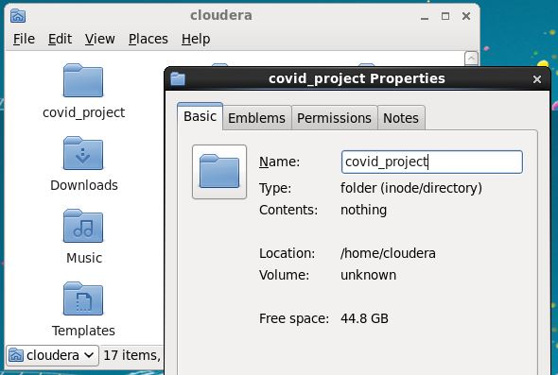
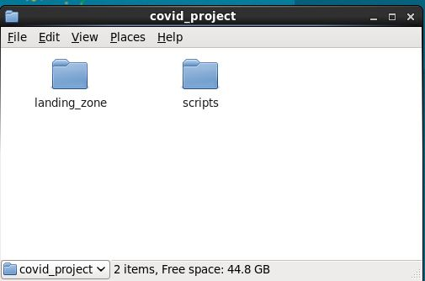
1. Create Folder on the Virtual Machine name it “/home/cloudera/covid_project”
2. Create folders under “covid_project”(landing_zone and scripts)

Slide 5
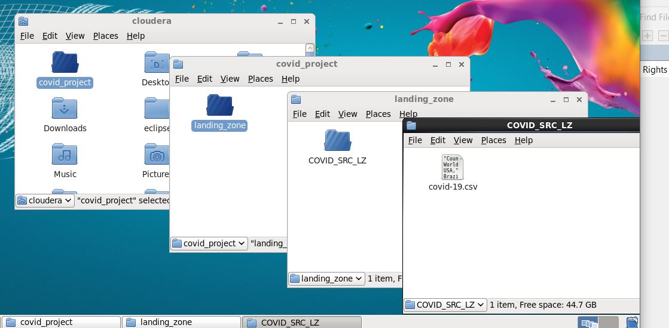
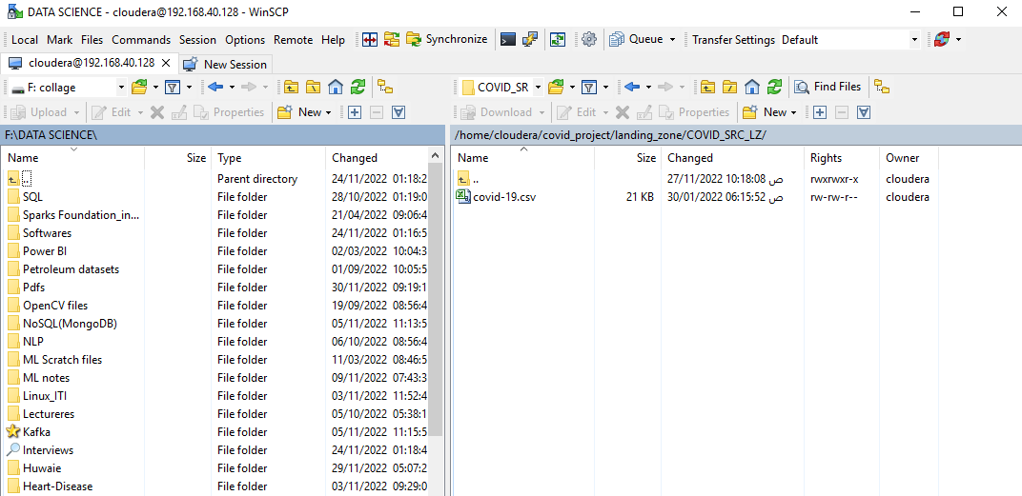
3. Upload dataset “covid-19.csv” into VM using WinSCP into landing zone name it “/home/cloudera/covid_project/landing_zone/COVID_SRC_LZ”

Slide 6
Storage
Big data storage is a storage infrastructure that is designed specifically to store, manage and retrieve massive amounts of data, or big data. Big data storage enables the storage and sorting of big data in such a way that it can easily be accessed, used and processed by applications and services working on big data
In this project we will use The Hadoop Distributed File System (HDFS) which is the primary data storage system used by Hadoop applications. The data was copied into HDFS file system through step 4

Slide 7
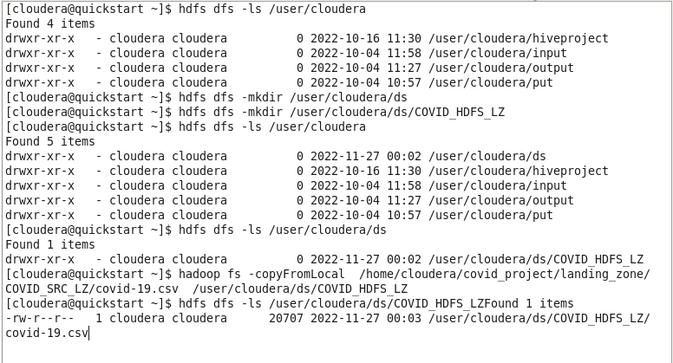
4. Load the dataset from “COVID_SRC_LZ” to HDFS directory name it “/user/cloudera/ds/COVID_HDFS_LZ” using HDFS cli commands in a shell script

Slide 8
HDFS.sh
#!/bin/bash
#Landing Zones in Linux and HDFS
LINUX_LANDING_AREA=/home/cloudera/covid_project/landing_zone/COVID_SRC_LZ
HDFS_LZ=/user/cloudera/ds/COVID_HDFS_LZ
echo "GLOBAL Variables= " $LINUX_LANDING_AREA ", " $HDFS_LZ
hdfs dfs -mkdir -p $HDFS_LZ
echo "COVID_HDFS_LZ CREATED sucessfully"
hdfs dfs -put $LINUX_LANDING_AREA/covid-19.csv $HDFS_LZ
echo "covid-19.csv dataset LOADED sucessfully"

Slide 9
Processing
Big data processing is a set of techniques or programming models to access large-scale data to extract useful information for supporting and providing decisions. In the following, we review some tools and techniques, which are available for big data analysis in datacenters.
In this project we used Hive which is a data warehouse infrastructure tool to process structured data in Hadoop. It resides on top of Hadoop to summarize Big Data, and makes querying and analyzing easy; this was done in step 6

Slide 10
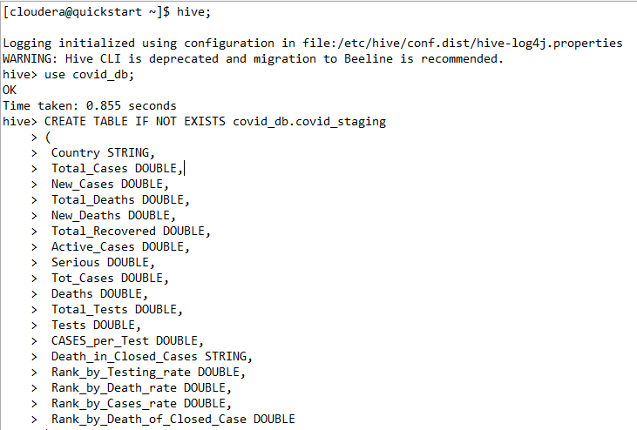
Hive.hql

Slide 11
Oozie workflow
Apache Oozie is a server-based workflow scheduling system to manage Hadoop jobs. Workflows in Oozie are defined as a collection of control flow and action nodes in a directed acyclic graph. Control flow nodes define the beginning and the end of a workflow as well as a mechanism to control the workflow execution path..
The way it was set up can be seen in steps 7,8 and 9

Slide 12
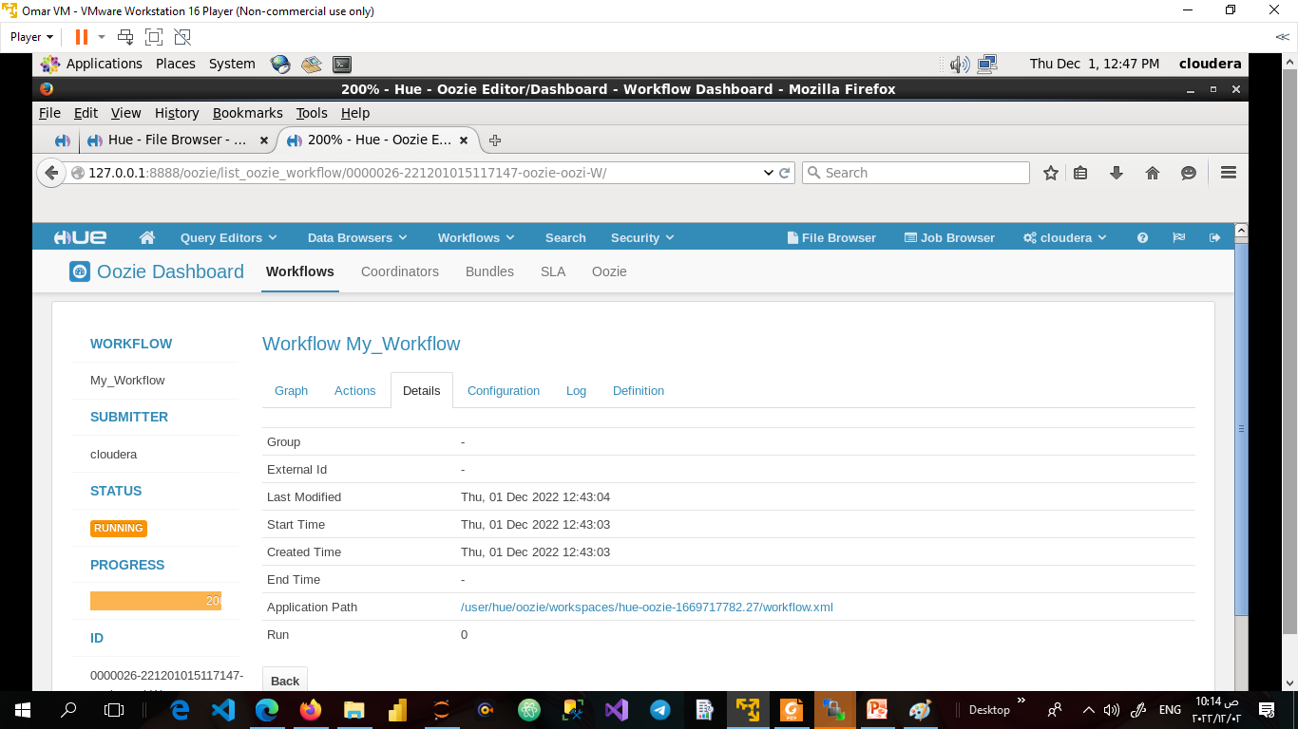
Running tasks

Slide 13
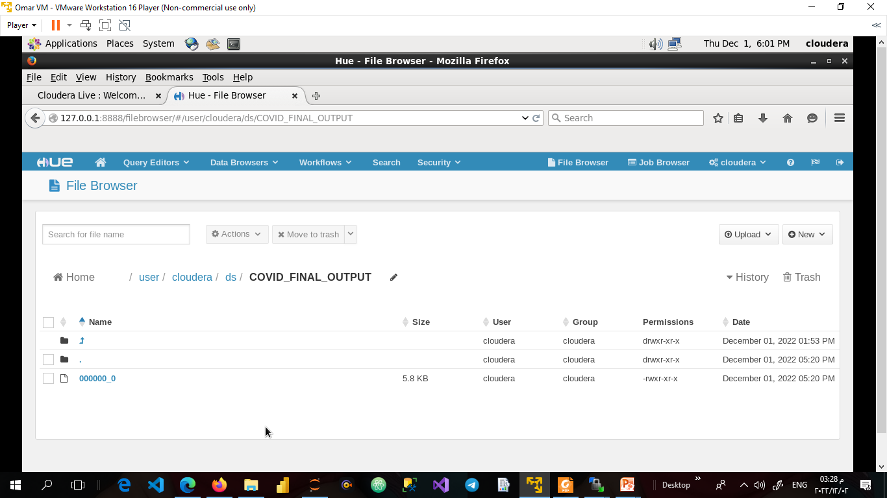
Final_output

Slide 14
visualization
Data visualization is the graphical representation of information and data. By using visual elements like charts, graphs, and maps, data visualization tools provide an accessible way to see and understand trends, outliers, and patterns in data.
In this project we used Power BI which is a business analytics service by Microsoft. It aims to provide interactive visualizations and business intelligence capabilities with an interface simple enough for end users to create their own reports and dashboards
The following slide shows the visualizations obtained using Power Bi

Slide 15
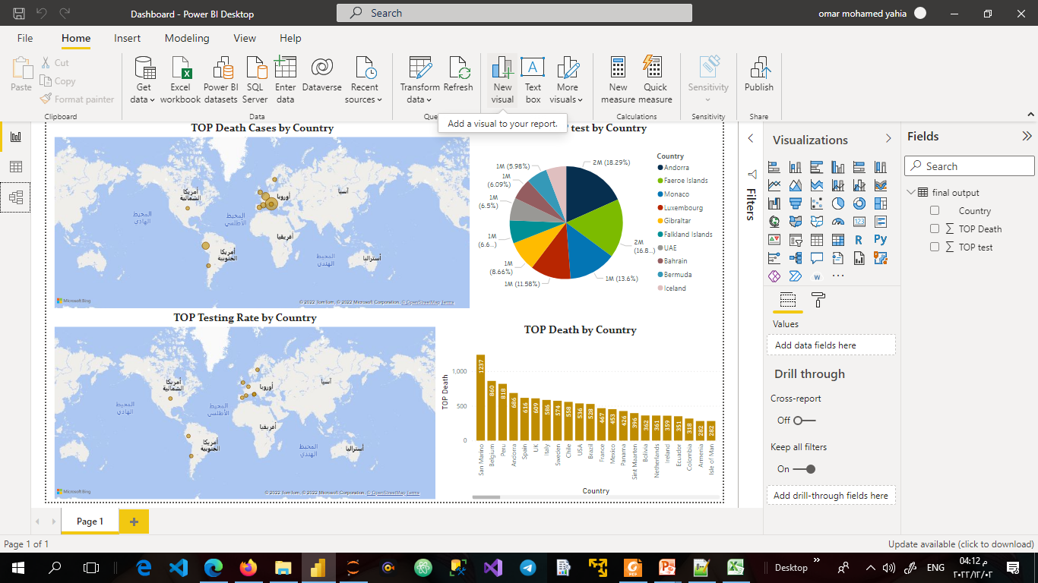
Dashboard

